Slide 1
Introduction to Compilers - 6 Syntax Analysis P2 Top Down Parsing
Textbook Chapter 4

Slide 2
Top-Down Parsing (Sec. 4.4)
Constructs a parse tree starting from the root and creates the nodes of the parse tree in preorder (depth-first)
Finds a leftmost derivation for an input string
Two top-down parsing methods
Recursive-descent parsing
Predictive parsing
Recursive
Nonrecursive

Slide 3
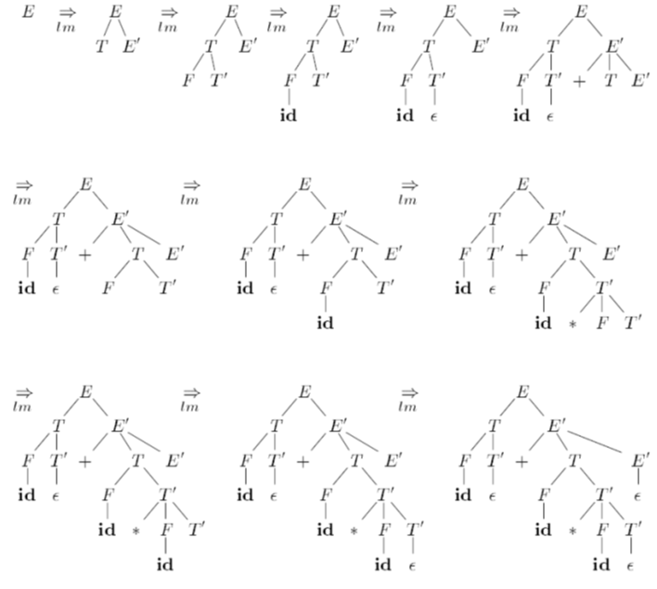
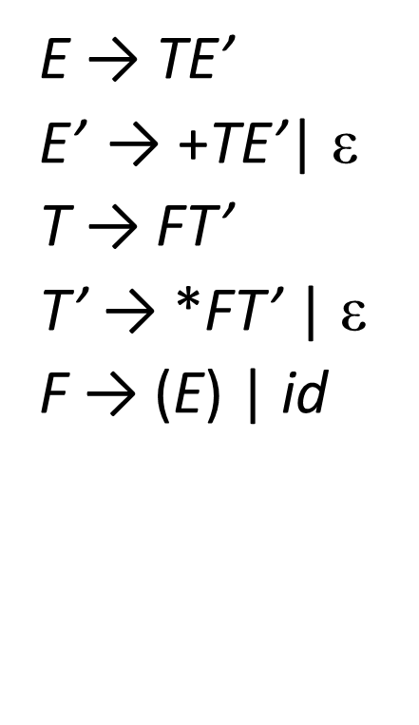
Top-Down Parsing (Sec. 4.4)
Top-down parser for id + id * id

Slide 4
Recursive-Descent Parsing
Intention
Try out all possibilities, i.e., do an exhaustive search to find a parse tree that parses the input string
May require backtracks (slow!!)
Example
S
S
S
S→ cAd
A→ ab | a
c
A
d
c
A
d
c
A
d
a
b
a
Input: cad
error!! backtrack
A left-recursive grammar can cause a recursive-decent parser
to go into an infinite loop

Slide 5
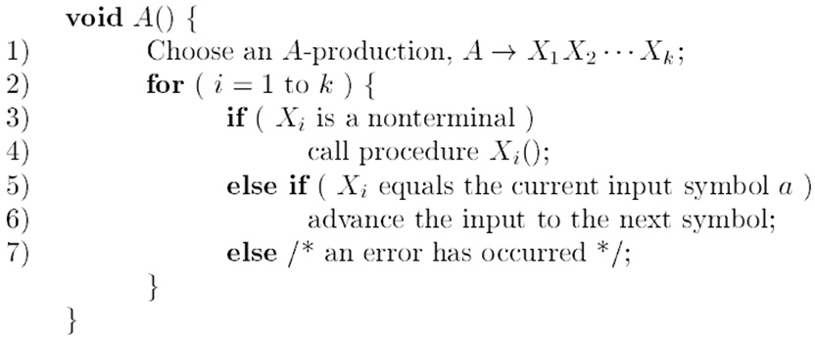
Recursive-Descent Parsing
To allow backtracking
Line (1) must try each of several productions
Failure at line (7) is not failure, it should return to line (1) and try another A-Production
If no more A-Production rule, we declare an input error
In order to try another A-Production, we need to reset the input pointer to where it was when we first reached line (1)

Slide 6
Predictive Parsing
A special case of recursive-descent parsing without backtracks
Intention
Lookahead: choose which production to apply based on the next input symbol
Two operations
FIRST()
FOLLOW()
Parsing Table
nonterminal + input symbol -> choosing which production
LL(1) grammar

Slide 7
FIRST()
FIRST(α), where α is any string of the grammar symbols
The set of terminals that begins the strings w derived from α
α ⇒ w
Example
If A ⇒ c γ, then c is in FIRST(A)
If c is in FIRST(A), then A ⇒ c γ
Usage
A→ α|β for choosing
If the next input symbol a is in FIRST(α), choose A→ α; otherwise choose A→ β (FIRST(α) ∩ FIRST(β)= ∅)
＊
＊
＊

Slide 8
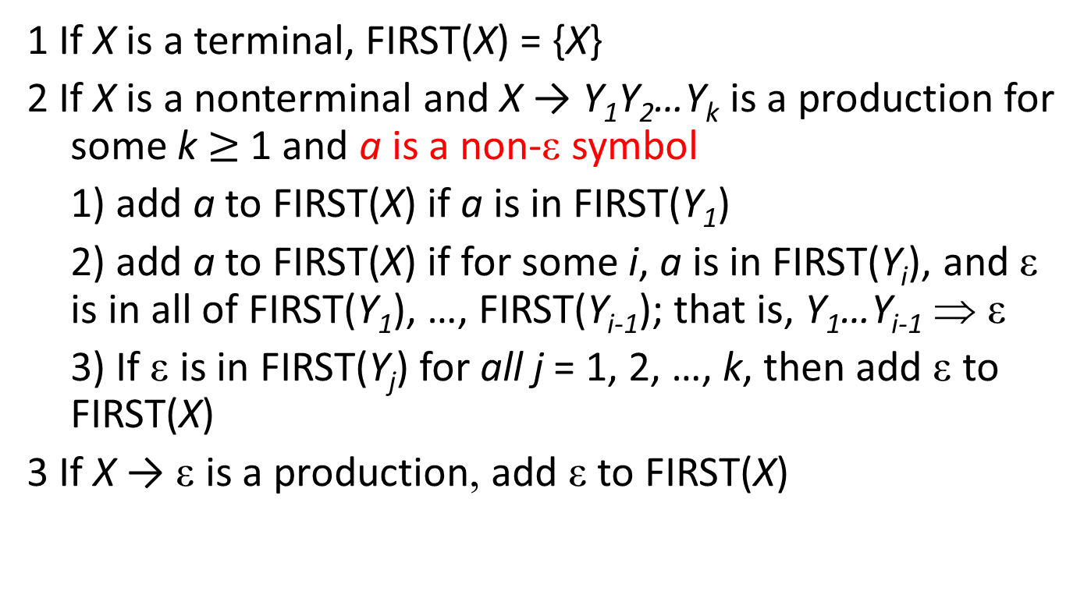
FIRST(X) computation
1 If X is a terminal, FIRST(X) = {X}
2 If X is a nonterminal and X → Y₁Y₂…Y_{k} is a production for some k $≥$ 1 and a is a non-ε symbol
1) add a to FIRST(X) if a is in FIRST(Y₁)
2) add a to FIRST(X) if for some i, a is in FIRST(Y_{i}), and ε is in all of FIRST(Y₁), …, FIRST(Y_{i-1}); that is, Y₁…Y_{i-1} ⇒ ε
3) If ε is in FIRST(Y_{j}) for all j = 1, 2, …, k, then add ε to FIRST(X)
3 If X → ε is a production, add ε to FIRST(X)
＊

Slide 9
Example
E → TE’ FIRST(F)={(, id}
E’ → +TE’| ε FIRST(T’)={*, ε}
T → FT’ FIRST(T)={(, id}
T’ → *FT’ | ε FIRST(E’)={+, ε}
F → (E) | id FIRST(E)={(, id}

Slide 10
More Examples
CASE1: CASE2:
E → F(E) E → FG(E)
F → id|ε F → id|ε
G → v|ε
FIRST(E)?
Notes:
CASE1: { id, ( }
CASE2: { id, v, ( }

Slide 11
FIRST() of a string
FIRST set of a string α =Y₁Y₂…Y_{k}
FIRST(α)?
1) add a to FIRST(α) if a is in FIRST(Y₁)
2) add a to FIRST(α) if for some i, a is in FIRST(Y_{i}), and ε is in all of FIRST(Y₁), …, FIRST(Y_{i-1}); that is, Y₁…Y_{i-1} ⇒ ε
3) If ε is in FIRST(Y_{j}) for all j = 1, 2, …, k, then add ε to FIRST(α)

Slide 12
FOLLOW()
FOLLOW(A), where A is an nonterminal
The set of terminals a that appear immediately to the right of A
a is in FOLLOW(A), iff S ⇒ αAaβ
If A can be the rightmost symbol in some sentential form, then $ is in FOLLOW(A)
＊

Slide 13
FOLLOW(A) computation
T compute FOLLOW(A) for all nonterminals A, apply the following rules until nothing can be added to any FOLLOW set
Place $ in FOLLOW(S), where S is the start symbol, and $ is the input endmarker
if A→αBβ, add FIRST(β)-{ε} to FOLLOW(B)
if A→αB, add FOLLOW(A) to FOLLOW(B)
if A→αBβ and ε is in FIRST(β), add FOLLOW(A) to FOLLOW(B)
α and β are strings

Slide 14
Example
E → TE’ FIRST(F)={(, id} FOLLOW(E)={$, )}
E’ → +TE’| ε FIRST(T’)={*, ε} FOLLOW(E’)={$, )}
T → FT’ FIRST(T)={(, id} FOLLOW(T)={+, $, )}
T’ → *FT’ | ε FIRST(E’)={+, ε} FOLLOW(T’)={+, $, )}
F → (E) | id FIRST(E)={(, id} FOLLOW(F)={*, +, $, )}
Notes:
Follow E = $+First( ) ), Follow E’ = Follow E, Follow T = First E’-ε+Follow E, Follow T’ = Follow T, Follow F = First T’-ε+Follow T

Slide 15
More Example
E → FG(E)
F → id|ε
G → v|ε
Is ( in the FOLLOW(F)?
Yes, FIRST(G(E)) includes (

Slide 16
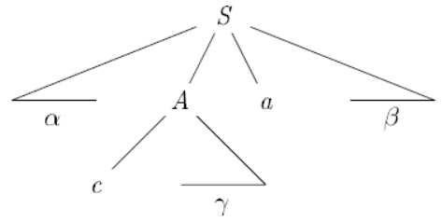
FIRST(A) and FOLLOW(A)

Slide 17
Construction of Parsing Table
For each production A → α, do the following steps
1. For each terminal a in FIRST(α), add A → α to M[A, a]
2. If ε is in FIRST(α), then for each terminal b in FOLLOW(A), add A → α to M[A, b]
3. If ε is in FIRST(α) and $ is in FOLLOW(A), add A → α to M[A, $]
Make each undefined entry to error

Slide 18
Example
E → TE’ FIRST(F)={(, id} FOLLOW(E)={$, )}
E’ → +TE’| ε FIRST(T’)={*, ε} FOLLOW(E’)={$, )}
T → FT’ FIRST(T)={(, id} FOLLOW(T)={+, $, )}
T’ → *FT’ | ε FIRST(E’)={+, ε} FOLLOW(T’)={+, $, )}
F → (E) | id FIRST(E)={(, id} FOLLOW(F)={*, +, $, )}
 | id | + | * | ( | ) | $
E | E → TE’ |  |  | E → TE’
E’ |  | E’ → +TE’ |  |  | E’ → ε | E’ → ε
T | T → FT’ |  |  | T → FT’
T’ |  | T’ → ε | T’ → *FT’ |  | T’ → ε | T’ → ε
F | F → id |  |  | F → (E)
So, predictive parsing = recursive-descent parsing + a parsing table.
If each entry in the parsing table has only one production, no backtracks occur.
Notes:
FIRST(TE’)=FIRST(T)
If each entry has only one production, no backtrack occur

Slide 19
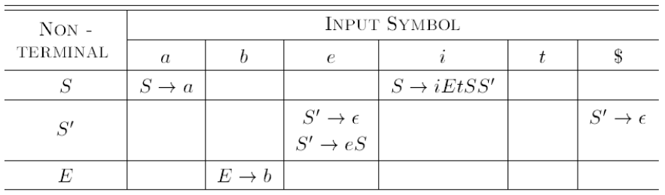
Example of an Ambiguous Grammar
S→iEtSS’|a FIRST(S)={i, a} FOLLOW(S)={$, e}
S’→eS| ε FIRST(S’)={e, ε} FOLLOW(S’)={$, e}
E→b FIRST(E)={b} FOLLOW(E)={t}

Slide 20
Usage of FIRST() and FOLLOW()
A→ α₁|α₂|…|α_{k}
Suppose the next input symbol is a
If a is in FIRST(α_{i}) for only one i, then choose A→ α_{i} for derivation
If a is in FIRST(α_{i}) for more than two i, then the grammar is not LL(1)
If a is not in FIRST(α_{i}) for all i, then the grammar still can be LL(1)
If there exists some i such that α_{i} ⇒ ε (i.e., A ⇒ α_{i} ⇒ ε) and a is in FOLLOW(A), then we choose the derivation A→ α_{i}
＊
＊

Slide 21
LL(1) grammars
LL(k) grammars
The class of grammars for which we can construct predictive parsers by looking k input symbols ahead
The first “L”: scan the input from left to right
The second “L”: leftmost derivation

Slide 22
Property of LL(1)
No ambiguous or left-recursive can be LL(1)
A grammar G is LL(1) iff whenever A → α | β are two distinct productions of G
No terminal a so that both α and β derive strings beginning with a
No terminal a in both FIRST(α) and FIRST(β)
At most one of α and β can derive the empty string
No ε in both FIRST(α) and FIRST(β)
If β ⇒ ε, α does not derive any string beginning with a terminal in FOLLOW(A)
If β ⇒ ε, no terminal in both FOLLOW(A) and FIRST(α)
＊
＊

Slide 23
LL(1) Grammar Example
stmt → if (expr) then stmt else stmt
| while (expr) stmt
| {stmt_list}
FIRST(if) ∩ FIRST(while) ∩ FIRST({)
= {if} ∩ {while} ∩ {{} = ∅
There is no ε-production

Slide 24
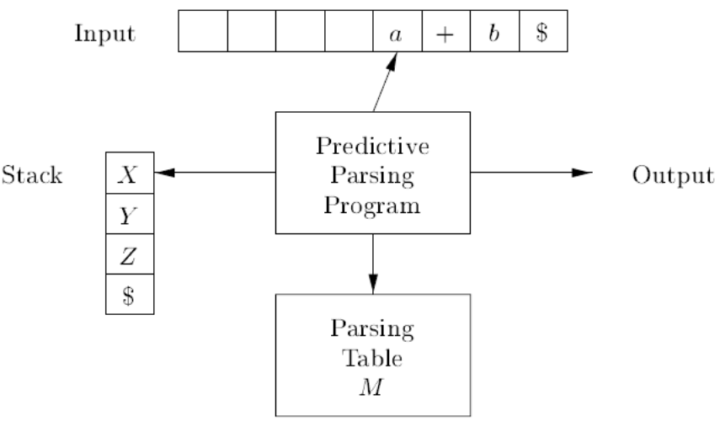
Non-recursive predictive parsing
Use a stack explicitly, rather then implicitly use recursive calls
Table-driven predictive parser

Slide 25
Algorithm
Initially, input buffer has w$ and stack has S$ with S on the top
Set ip to the first symbol of w
Set X to the top stack symbol
While (X!=$){
if (X==a) pop the stack and advance ip; /* a is pointed by ip */
else if (X is a terminal) error();
else if (M[X, a] is an error entry) error();
else if (M[X, a] = X → Y₁Y₂…Y_{k}){
output the production X → Y₁Y₂…Y_{k};
pop the stack;
push Y_{k}Y_{k-1}…Y₁ onto the stack with Y₁ on top;
}
set X to the top stack symbol;
}

Slide 26
Example
Stack | Input | Action
$E | id+id*id$ | Output E → TE’
$E’T | id+id*id$ | Output T → FT’
$E’T’F | id+id*id$ | Output F → id
$E’T’id | id+id*id$ | Match id
$E’T’ | +id*id$ | Output T’ → ε
$E’ | +id*id$ | Output E’ → +TE’
$E’T+ | +id*id$ | Match +
$E’T | id*id$ | Output T → FT’
$E’T’F | id*id$ | Output F → id
$E’T’id | id*id$ | Match id
$E’T’ | *id$ | Output T’ → *FT’
$E’T’F* | *id$ | Match *
$E’T’F | id$ | Output F → id
$E’T’id | id$ | Match id
$E’T’ | $ | Output T’ → ε
$E’ | $ | Output E’ → ε
$ | $ | accept

Slide 27
Concluding Remarks
Top-down parsing
Recursive-descent parsing
Backtrack
Predictive parsing
Recursive predictive parsing
No backtrack
Parsing table
FIRST() and FOLLOW()
Nonrecursive predictive parsing
Stack
Parsing table
FIRST() and FOLLOW()

